Slide 1
Extreme programming (XP)

Slide 2
Extreme Programming (XP) is one of the numerous Agile frameworks applied by IT companies.
Software engineer Ken Beck introduced XP in the 90s with the goal of finding ways to write high-qualitative software quickly and being able to adapt to customers’ changing requirements.
XP is a set of engineering practices. Developers have to go beyond their capabilities while performing these practices. That’s where the “extreme” in the framework’s title comes from.
The XP framework normally involves 5 phases or stages of the development process that iterate continuously:
Planning, the first stage, is when the customer meets the development team and presents the requirements in the form of user stories to describe the desired result. The team then estimates the stories and creates a release plan broken down into iterations needed to cover the required functionality part after part. If one or more of the stories can’t be estimated, so-called spikes can be introduced which means that further research is needed.
2.Designing is actually a part of the planning process, but can be set apart to emphasize its importance. It’s related to one of the main XP values that we’ll discuss below — simplicity. A good design brings logic and structure to the system and allows to avoid unnecessary complexities and redundancies.

Slide 3
3.Coding is the phase during which the actual code is created by implementing specific XP practices such as coding standards, pair programming, continuous integration, and collective code ownership
4.Testing is the core of extreme programming. It is the regular activity that involves both unit tests (automated testing to determine if the developed feature works properly) and acceptance tests (customer testing to verify that the overall system is created according to the initial requirements).
5.Listening is all about constant communication and feedback. The customers and project managers are involved to describe the business logic and value that is expected.

Slide 4
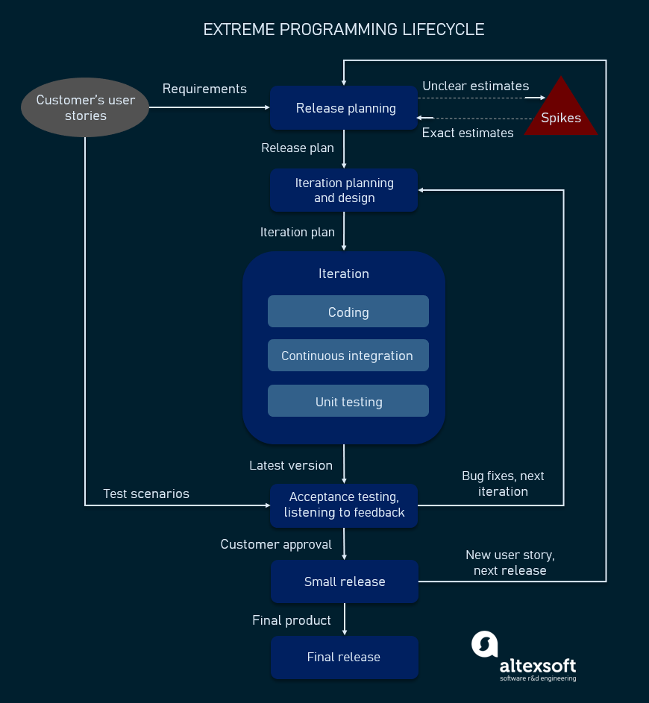

Slide 5
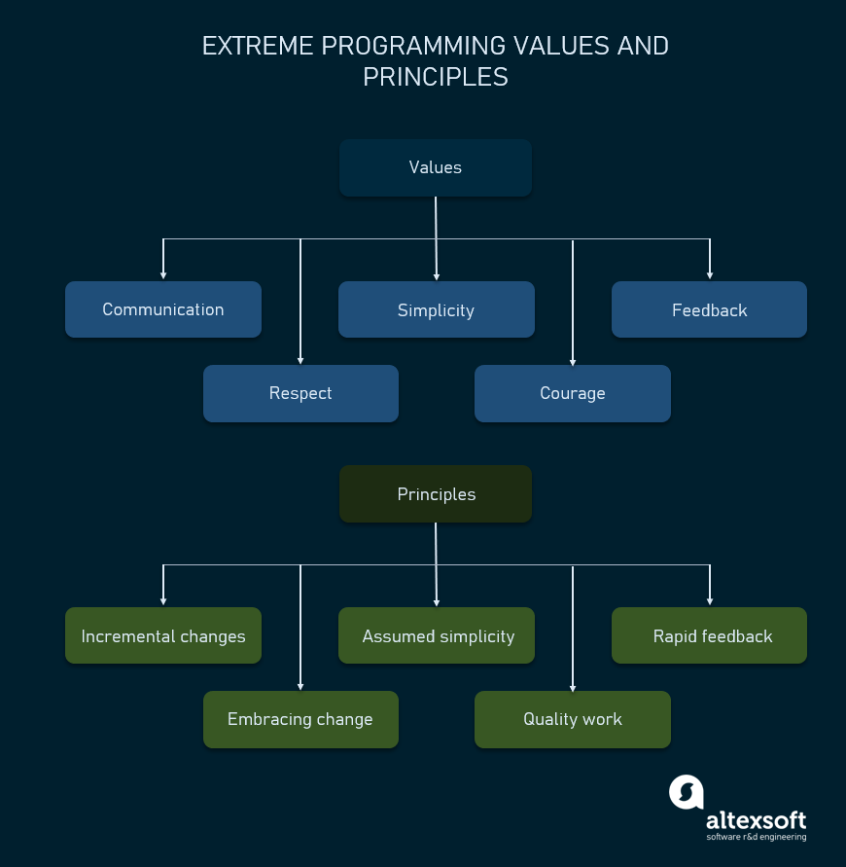

Slide 6
Extreme programming or XP suggests values , rules and practices. By adopting these practices projects will become flexible with respect to changes.
XP values
Extreme Programming has 5 values .They are:
Communication : Everyone is part of the team . Do face to face communication with the team
Simplicity : Do what is needed
Feedback : Demonstrate working software early and adapt to feedback
Courage : Tell the truth about progress and estimates
Respect : Everyone is a a valued team member and contributes value which includes the customer

Slide 7
Principles of extreme programming
Most researchers denote 5 XP principles as:
Rapid feedback. Team members understand the given feedback and react to it right away.
Assumed simplicity. Developers need to focus on the job
Incremental changes. Small changes made to a product step by step work better than big ones made at once.
Embracing change. If a client thinks a product needs to be changed, programmers should support this decision and plan how to implement new requirements.
Quality work. A team that works well, makes a valuable product and feels proud of it.
Having discussed the main values and principles of XP, let’s take a closer look at the practices inherent in this framework.

Slide 8
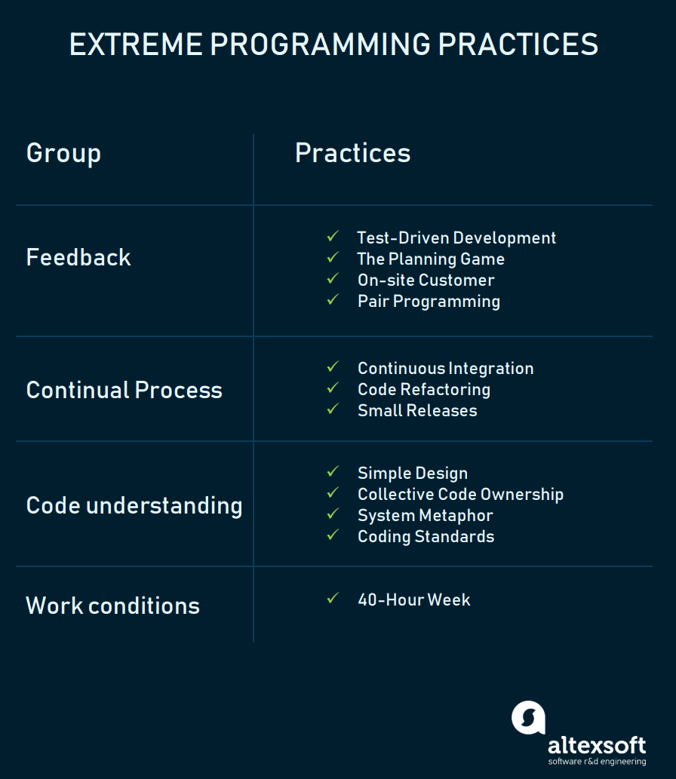
Extreme programming practices
The practices of XP are a set of specific rules and methods that distinguishes it from other methodologies. When used in conjunction(combo), they reinforce(support) each other, help mitigate(reduce) the risks of the development process, and lead to the expected high-quality result. XP suggests using 12 practices while developing software which can be clustered into four groups.

Slide 9
Test-Driven Development
Test-driven development (TDD) is a software development process relying on software requirements being converted to test cases before software is fully developed, and tracking all software development by repeatedly testing the software against all test cases.
The Planning Game
This is a meeting that occurs at the beginning of an iteration cycle. The development team and the customer get together to discuss and approve a product’s features. At the end of the planning game, developers plan for the upcoming iteration and release, assigning tasks for each of them.
On-site Customer
As we already mentioned, according to XP, the end customer should fully participate in development. The customer should be present all the time to answer team questions, set priorities, and resolve disputes if necessary.

Slide 10
Pair Programming
This practice requires two programmers to work jointly on the same code. While the first developer focuses on writing, the other one reviews code, suggests improvements, and fixes mistakes along the way. Such teamwork results in high-quality software and faster knowledge sharing but takes about 15 percent more time. In this regard, it’s more reasonable trying pair programming for long-term projects.
Code Refactoring
To deliver business value with well-designed software in every short iteration, XP teams also use refactoring. The goal of this technique is to continuously improve code. Refactoring is about removing redundancy, eliminating unnecessary functions, increasing code coherency(the quality of being logical and consistent.), and at the same time decoupling elements. Keep your code clean and simple, so you can easily understand and modify it when required would be the advice of any XP team member.

Slide 11
Continuous Integration
Developers always keep the system fully integrated. XP teams take iterative development to another level because they commit code multiple times a day, which is also called continuous delivery. XP practitioners understand the importance of communication. Programmers discuss which parts of the code can be re-used or shared. This way, they know exactly what functionality they need to develop. The policy of shared code helps eliminate integration problems. In addition, automated testing allows developers to detect and fix errors before deployment.
Small Releases
This practice suggests releasing the Minimum Viable Product quickly and further developing the product by making small and incremental updates. Small releases allow developers to frequently receive feedback, detect bugs early, and monitor how the product works in production. One of the methods of doing so is the continuous integration practice (CI) we mentioned before.
Simple Design
The best design for software is the simplest one that works. If any complexity is found, it should be removed. The right design should pass all tests, have no duplicate code, and contain the fewest possible methods and classes. It should also clearly reflect the programmer’s intent.

Slide 12
Coding Standards
A team must have common sets of coding practices, using the same formats and styles for code writing. Application of standards allows all team members to read, share, and refactor code with ease, track who worked on certain pieces of code, as well as make the learning faster for other programmers. Code written according to the same rules encourages collective ownership.
Collective Code Ownership
This practice declares a whole team’s responsibility for the design of a system. Each team member can review and update code. Developers that have access to code won’t get into a situation in which they don’t know the right place to add a new feature. The practice helps avoid code duplication. The implementation of collective code ownership encourages the team to cooperate more and feel free to bring new ideas.
System Metaphor
System metaphor(Representation) stands for a simple design that has a set of certain qualities. First, a design and its structure must be understandable to new people. They should be able to start working on it without spending too much time examining specifications. Second, the naming of classes and methods should be coherent. Developers should aim at naming an object as if it already existed, which makes the overall system design understandable.
40-Hour Week
XP projects require developers to work fast, be efficient, and sustain the product’s quality. To adhere to these requirements, they should feel well and rested. Keeping the work-life balance prevents professionals from burnout. In XP, the optimal number of work hours must not exceed 45 hours a week.

Slide 13
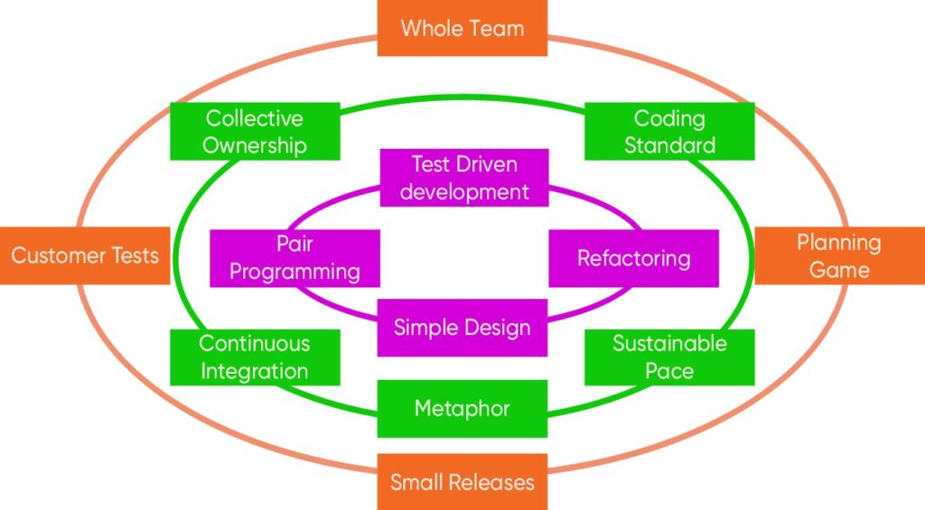

Slide 14
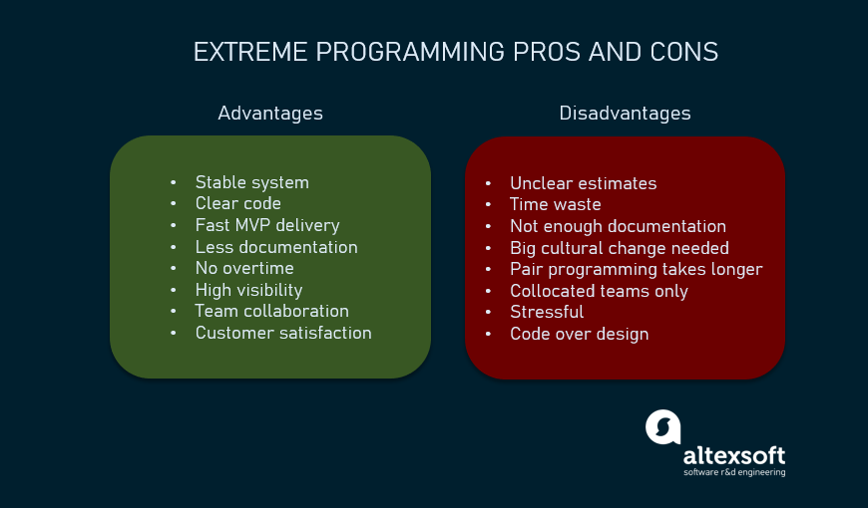
Advantages and disadvantages of XP

Slide 15
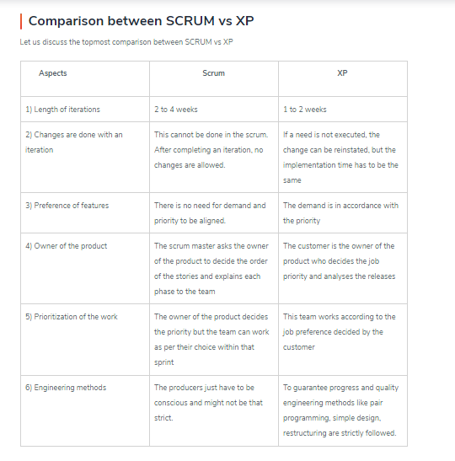
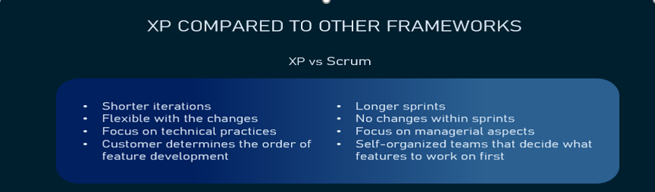

Slide 16
Extreme programming vs Scrum
Scrum is commonly associated with self-organizing teams. It also usually has sprints that are 2 to 4 weeks long, while XP iterations are shorter, taking 1 to 2 weeks.
Besides, XP is much more flexible with possible changes within iterations, while Scrum doesn’t allow any modifications after the sprint backlog is set.
Another difference is that in XP the customer prioritizes features and decides on the order of their development, but in Scrum the team itself determines what to work on first.
Scrum’s main roles are Product Owner, Scrum Master, and Scrum Team, which are different from those in XP.

Slide 17
When to use XP
Now that we discussed the XP methodology pros and cons and identified its place among other agile frameworks, we can talk about the cases when it’s applicable. It’s important to make sure a company’s size, structure, and expertise, as well as the staff’s knowledge base allow for applying XP practices. These are the factors to consider.
Highly-adaptive development. Some systems don’t have constant functionality features and implies frequent changes. XP was designed to help development teams adapt to fast-changing requirements.
Risky projects. Teams applying XP practices are more likely to avoid problems connected with working on a new system, especially when a customer sets strict deadlines for a project. Additionally, a high level of customer engagement reduces the risk of their not accepting the end product.
Small teams. XP practices are efficient for teams that don’t exceed 12 people. Managing such groups is usually easier, communication is more efficient, and it takes less time to conduct meetings and brainstorming sessions.
Automated testing. Another factor that can influence the choice of XP is the developers’ ability to create and run unit tests, as well as availability of the necessary testing tools.

Slide 18
When to use extreme programming
Extreme programming is the most suitable in the following scenarios:
If the software requirements change frequently
When the system functionality changes within a few months
If the customer requirement is not clear
When mitigating project risk is urgent especially in case of tight deadlines
When the number of programmers is limited
When automated unit and functional test cases can be created
Fixed time project with new technology
If continuous development and collaboration are priorities for the team
How does XP help in the above scenarios? – Since XP is a highly adaptable model, this encourages ongoing feedback from customers, enables developers to work together, and at the same time anticipates the errors along the way. As a result, XP produces better product releases with improved productivity.

